Slide 1
23RD EUROPEAN CONFERENCE ON
FEW-BODY PROBLEMS IN PHYSICS
From J/ψ to LHCb Pentaquark
……and beyond
F. Fernández¹, D.R. Entem¹, P.G. Ortega², J. Segovia³
1) GFN & IUFFyM Universidad de Salamanca
2) IFIC Universidad de Valencia
3) Physik Department Technische Universität München
1

Slide 2
23RD EUROPEAN CONFERENCE ON
FEW-BODY PROBLEMS IN PHYSICS
The hadron physics in the heavy quark sector is indeed
a Few Body Problem
Outline
Motivation
The model:constituent quarks, coupled channels formalism, 3P0 model
Results
Conclusions
2

Slide 3
23RD EUROPEAN CONFERENCE ON
FEW-BODY PROBLEMS IN PHYSICS
The two body problem
3

Slide 4
23RD EUROPEAN CONFERENCE ON
FEW-BODY PROBLEMS IN PHYSICS
On November 10-th 1974, at SLAC and BNL an extremely narrow resonance was discovered at an energy of about 3100 MeV
The resonance was immediately confirmed at Frascati
Its small width couldn't be explained in terms of the known quarks u,d or s
This resonance was called J at BNL and ψ at SLAC
4

Slide 5
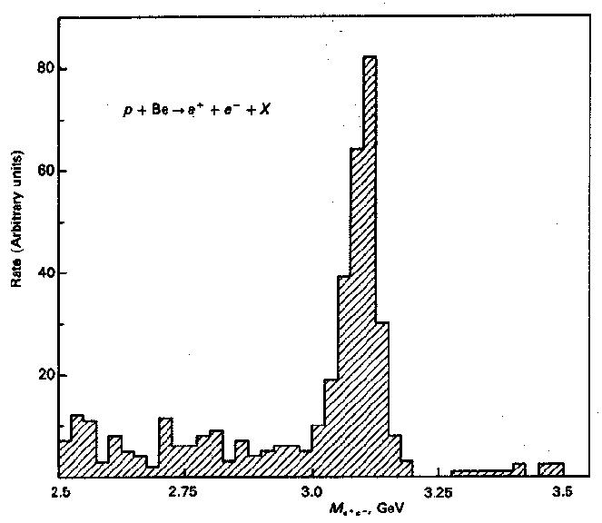
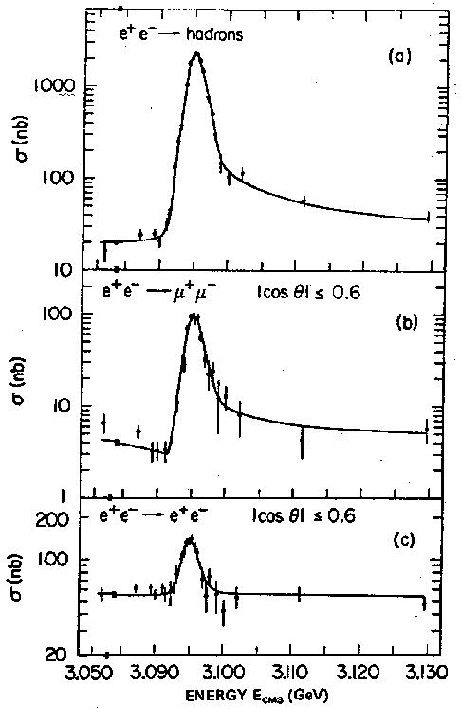
23RD EUROPEAN CONFERENCE ON
FEW-BODY PROBLEMS IN PHYSICS
The 1974 November revolution
The discovery of the J/ψ
at SLAC…
…and at the Brookhaven
National Laboratory
5

Slide 6
23RD EUROPEAN CONFERENCE ON
FEW-BODY PROBLEMS IN PHYSICS
A few years before, Glashow, Iliopoulos and Maiani proposed a model to explain the absence of the ΔS=1 neutral weak currents:
This model predicted the existence of a new quark “charm” with charge +2/3
The discovery of the J/ψ confirmed this prediction and was actually the definitive confirmation of the existence of quarks
6

Slide 7
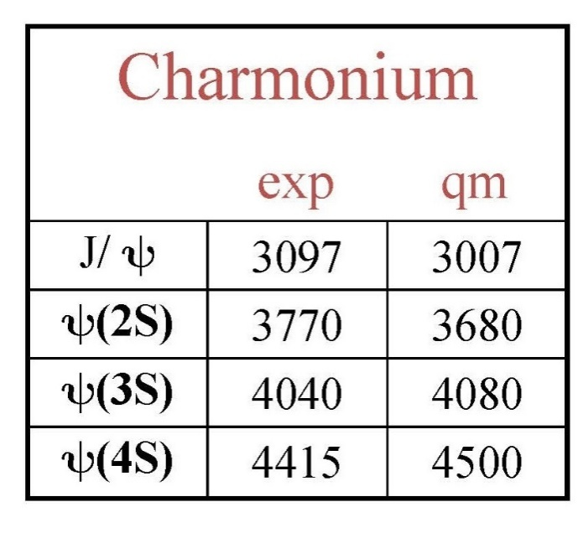
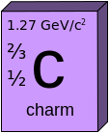
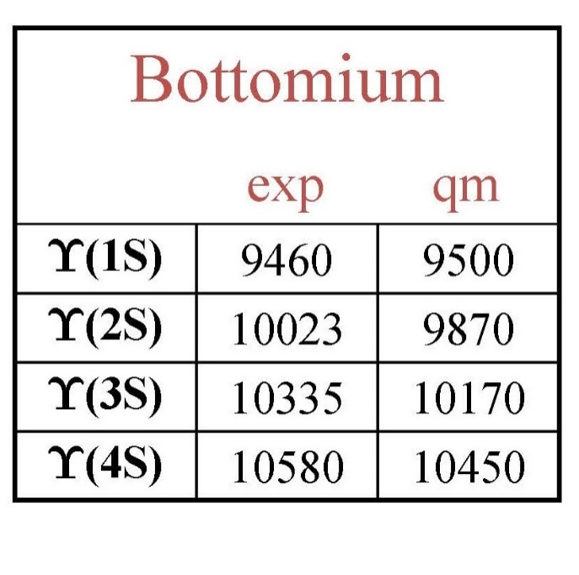
23RD EUROPEAN CONFERENCE ON
FEW-BODY PROBLEMS IN PHYSICS
Non relativistic two body problem
V(r)
Bottomonium
r
7

Slide 8
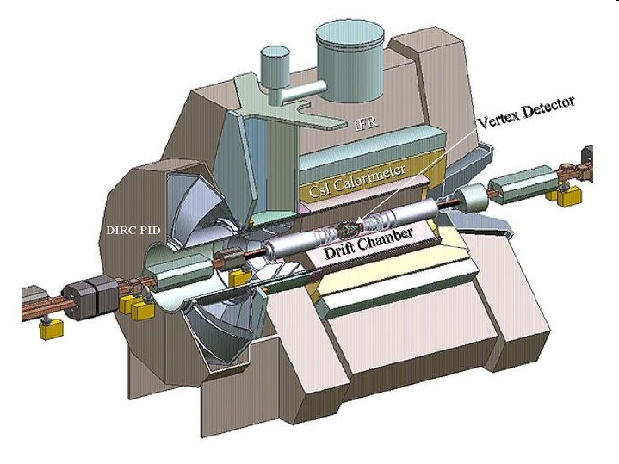
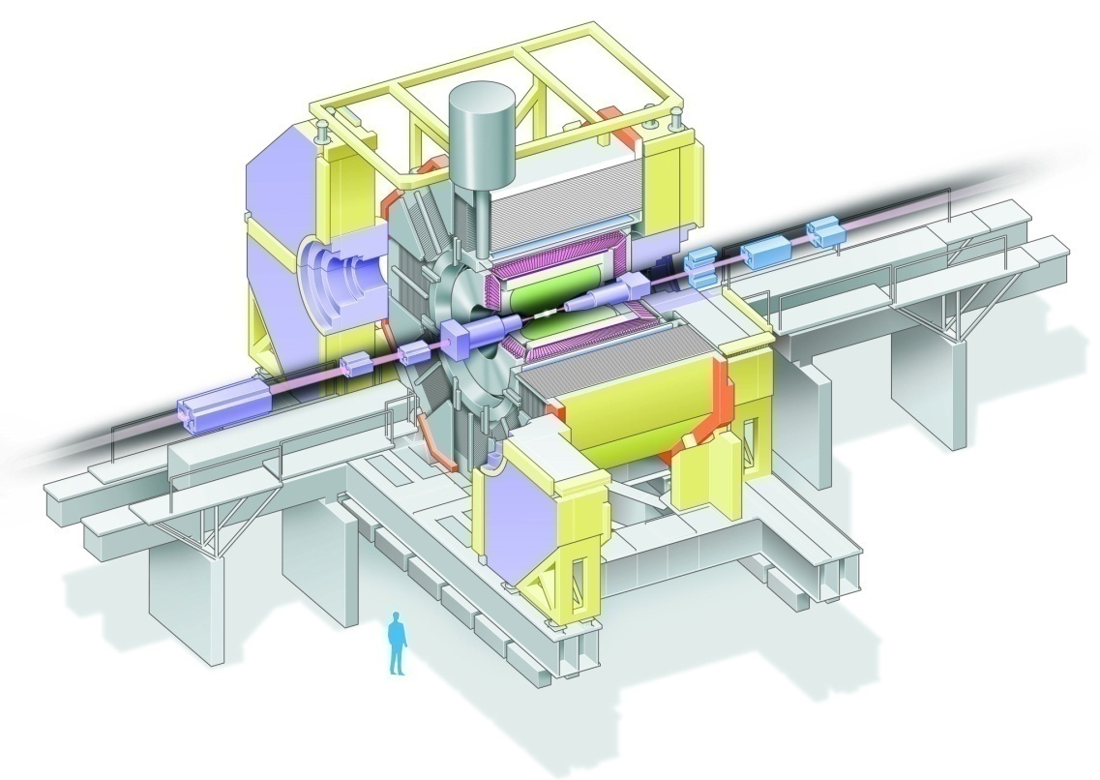
23RD EUROPEAN CONFERENCE ON
FEW-BODY PROBLEMS IN PHYSICS
B-factories
@ KEK
@ SLAC
e⁺e– → ϒ(4S)
E_{cms} ~ 10.6 GeV
Data taking : 2000 – 2010
8

Slide 9
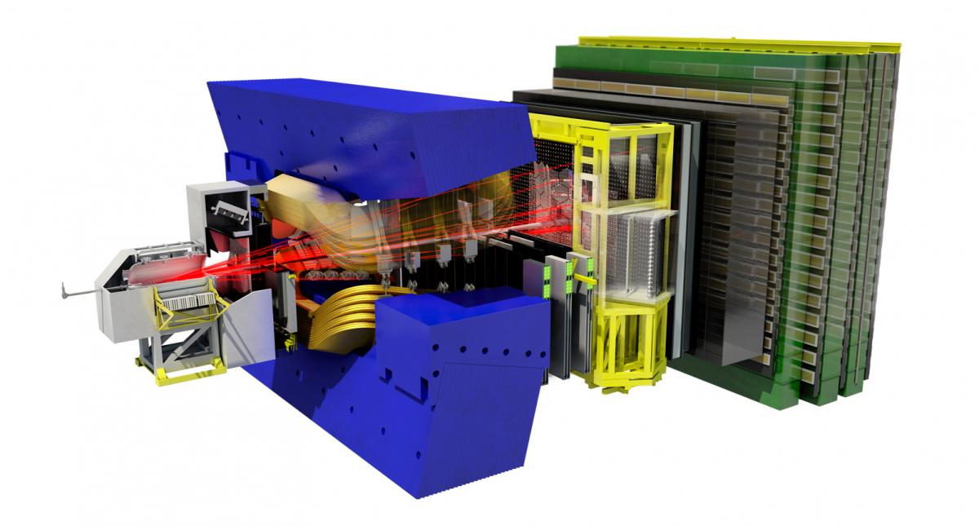
23RD EUROPEAN CONFERENCE ON
FEW-BODY PROBLEMS IN PHYSICS
9

Slide 10
23RD EUROPEAN CONFERENCE ON
FEW-BODY PROBLEMS IN PHYSICS
The few body problem
10

Slide 11
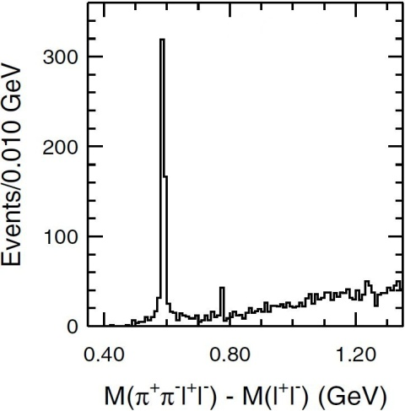
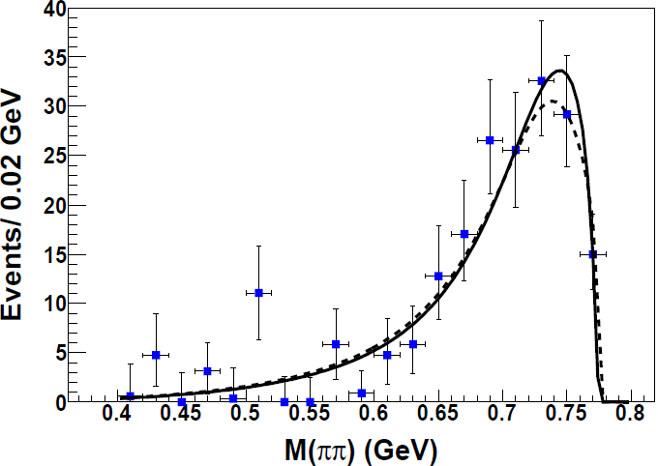
23RD EUROPEAN CONFERENCE ON
FEW-BODY PROBLEMS IN PHYSICS
2003
ψ(2S)
X(3872) was observed by Belle in
B⁺ → K⁺ X(3872)
→ J/ψ π⁺ π⁻
X(3872)
Mass close to D*⁰D⁰ threshold: δm = – 0.09 ± 0.34 MeV
⟨M⟩ = 3871.63 ± 0.19 MeV , Γ < 1.2 MeV (90% C.L.)
⟨M⟩ = 3871.63 ± 0.19 MeV , Γ < 1.2 MeV (90% C.L.)
X(3872) → J/ψ π⁺ π⁻
Cannot be a pure state
M(π⁺π⁻)
⇒ π⁺π⁻ pair is produced via ρ⁰
X(3872) is observed in isospin-violating mode
It is very unlikely that X (3872) is a charmonium state
11

Slide 12
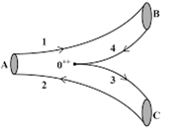
23RD EUROPEAN CONFERENCE ON
FEW-BODY PROBLEMS IN PHYSICS
J^{PC} =1⁺⁺ X(3872) (D* D threshold)
Q
q
Q
Q
(L=0)
(L=1)
Q
q
Two states almost degenerated
Coupled channel
12

Slide 13
23RD EUROPEAN CONFERENCE ON
FEW-BODY PROBLEMS IN PHYSICS
Two different scenarios:
Strong coupling with meson-meson channels
The coupling shift substantially the energy of the two quark state (mass shift)
b) If strong enough may create new extra states (XYZ states)
Weak coupling
a) The coupling shift slightly the energy of the two quark state
b) No extra states ( but some threshold effects are posibles)
13

Slide 14
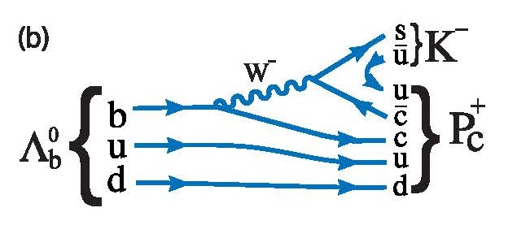
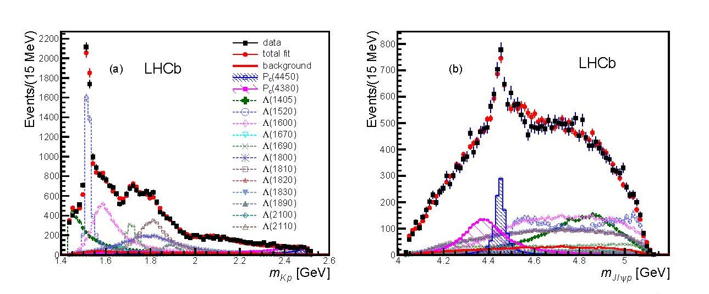
2015 LHCb Pentaquark
PhysRevLett.115.072001
14

Slide 15
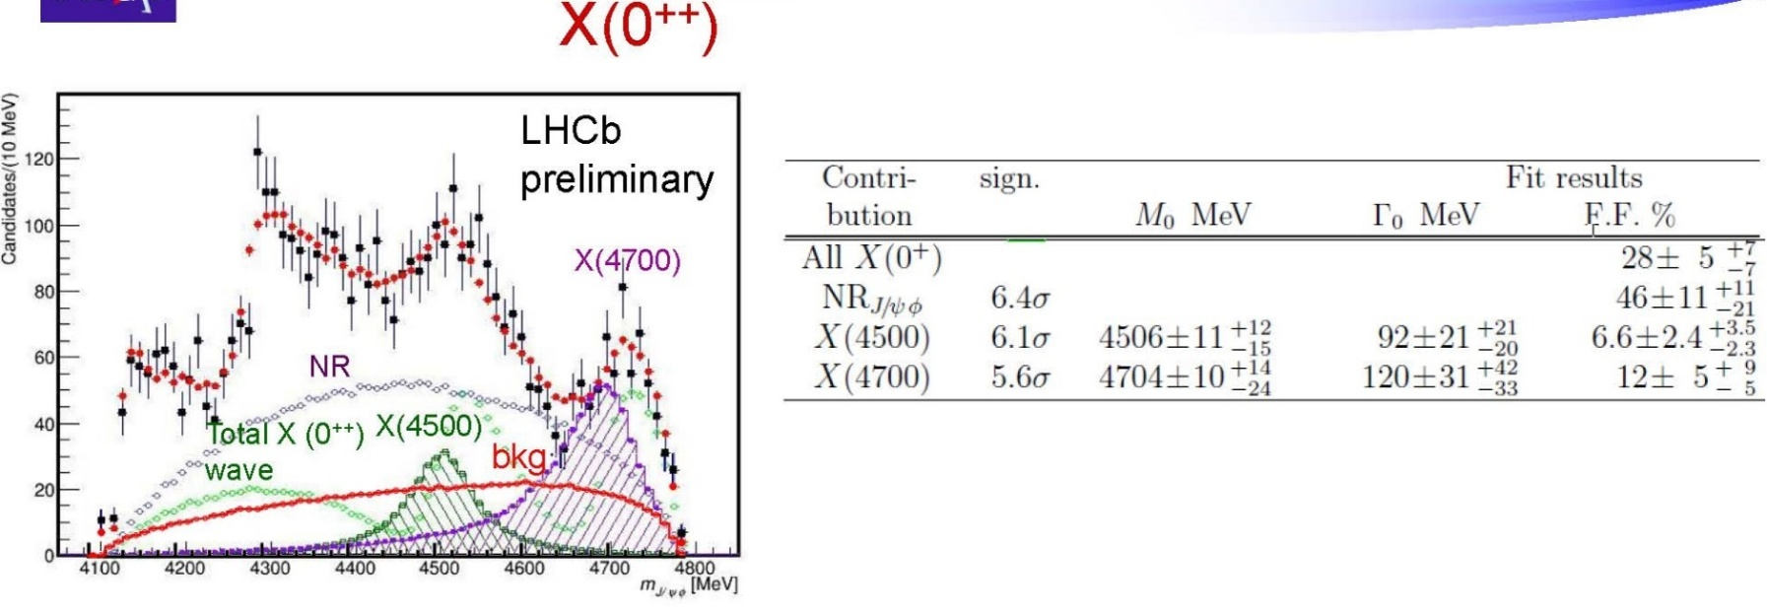
2016 what else?
15

Slide 16
Theoretical Ingredients
Two body model: Constituent Quark Model
Coupled channel model: RGM
Coupling : Pair Creation Model (³P ₀)
16

Slide 17
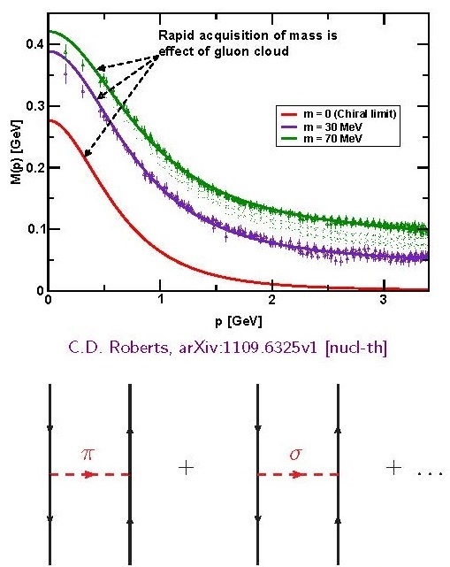
The constituent quark model
17

Slide 18
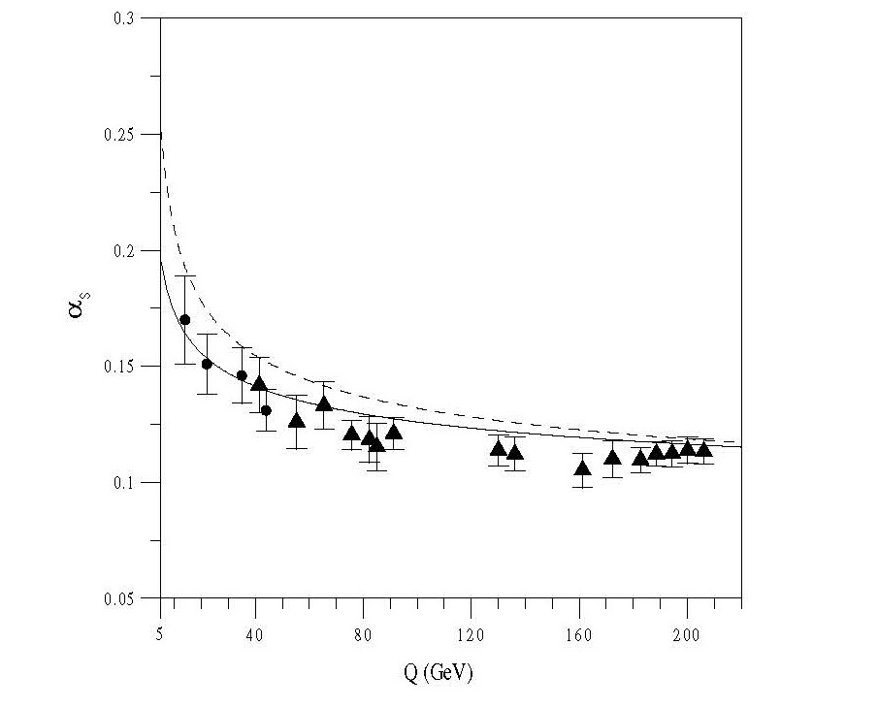
The constituent quark model
One Gluon Exchange
Confinement
18

Slide 19
N-N interaction
F. Fernández, A. Valcarce, U. Straub, A. Faessler. J. Phys. G19, 2013 (1993)
A. Valcarce, A. Faessler, F. Fernández. Phys. Lett. B345, 367 (1995)
D.R. Entem, F. Fernández, A. Valcarce. Phys. Rev. C62 034002 (2000)
B. Juliá-Diaz, J. Haidenbauer, A. Valcarce, and F. Fernández. Phys.Rev.C 65, 034001, (2002)
Baryon spectrum
H. Garcilazo, A. Valcarce, F. Fernández. Phys. Rev. C 64, 058201, (2001)
H. Garcilazo, A. Valcarce, F. Fernández. Phys. Rev. C 63, 035207 (2001)
Meson spectrum.
J. Vijande, F. Fernández, A. Valcarce. J. Phys. G31, (2005)
J. Segovia, A. M. Yasser, D. R. Entem, F. Fernandez Phys. Rev D. 78 114033 (2008)
.Reports
A. Valcarce, H. Garcilazo, F. Fernandez, P.Gonzalez Rep. Prog. Phys. 68 965 (2005)
J. Segovia, D. R. Entem, F. Fernandez, Int. Jour. Mod. Phys. E 22 1330026 (2013)
19
Notes:
Diapositiva 4.
SIMULTANEIDAD
This model has been able to describe the NN interaction (NN phase shifts and deuteron phenomenology), the triton binding energy, baryon spectroscopy and meson spectroscopy and decays.

Slide 20
Solving the two body problem
To found the quark-antiquark bound states we solve the Schrödinger equation using the Gaussian Expansion Method
The coeficients b_{n} and the eigenenergy E are determined from the Rayleigh-Ritz variational principle
20

Slide 21
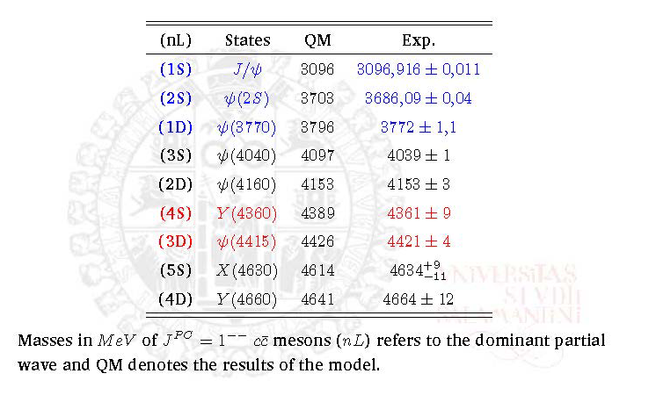
Results for the 1⁻ ⁻ sector
PRD 78 114033 (2008)
21

Slide 22
Coupling the states of two and four quarks (3P0 model)
22

Slide 23
Solving the coupled channel problem
23

Slide 24
24

Slide 25
25
J. Phys. G 40 085107 (2013)

Slide 26
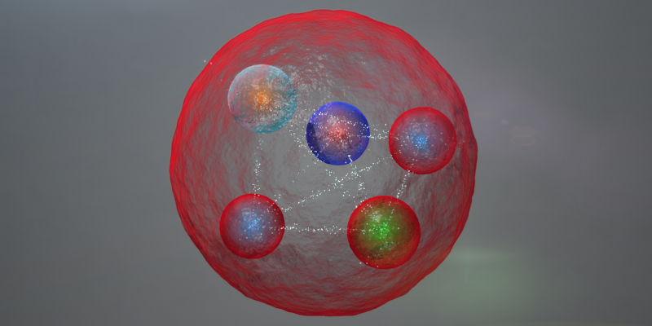
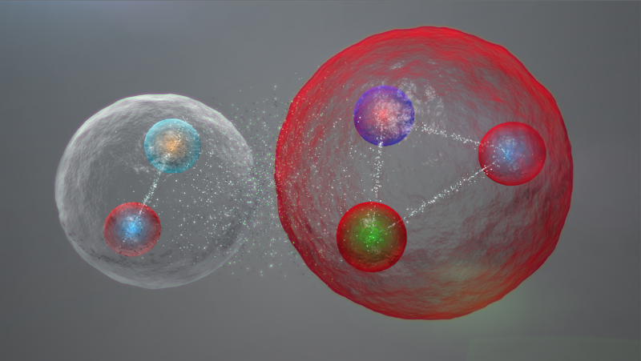
Pentaquark
P_{c}(4380), P_{c}(4450)
DΣ*_{c} threshold
D*Σ_{c} threshold
26

Slide 27
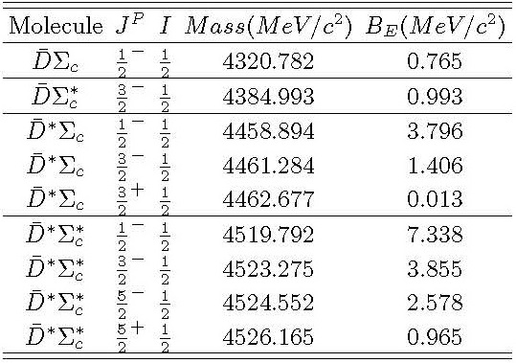
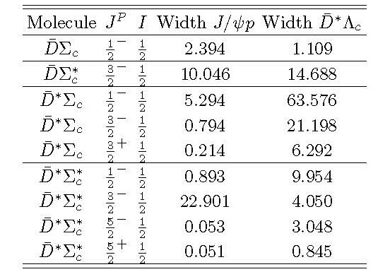
Pentaquark
P_{c}(4380),P_{c}(4450)
27

Slide 28
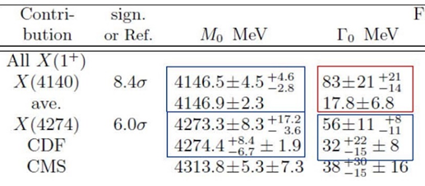
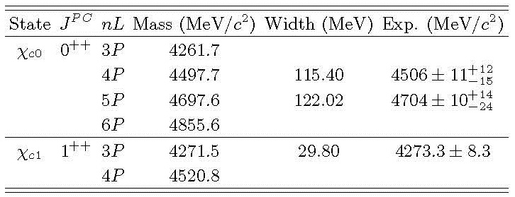
New LHCb resonances
Quark model predictions
28

Slide 29
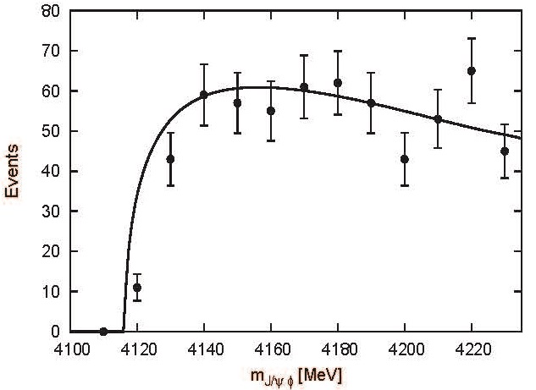
Coupled channel calculation (DsDs,D*sD*s, DsD*s,J/ψφ)
As we do not find any signal for the X(4140), neither bound nor virtual, we analysed the line shapes of the J/ψφ channel as an attempt to explain the X(4140) as a simple threshold cusp.
29

Slide 30
Conclusions
1. The hadron physics in the heavy quark sector is indeed a
Few Body Problem
2. The heavy quark sector shows a rich phenomenology including two, (three), four and five body problems depending of the dynamics
3. A constituent quark model plus a coupled channels calculation can account for this phenomenology from the J/ψ to pentaquarks
Thanks for your attention
30

