Slide 1
Dust-related science cases for the GLT
Darach Watson
Dark Cosmology Centre, Niels Bohr Institute, Copenhagen

Slide 2
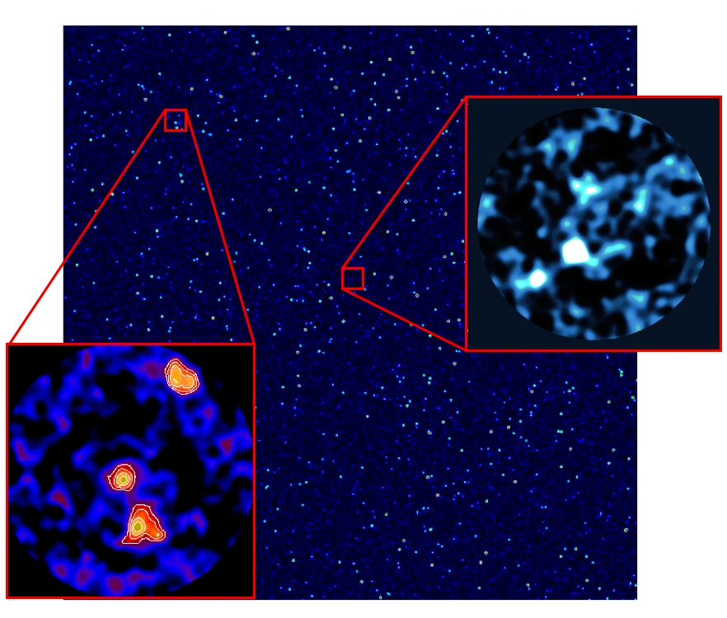
THz cosmology survey
Similar to Scuba 2 Cosmology Legacy Survey (right)
S2CLS has 450µm coverage to 1.3-mJy rms of 140sq. arcmin. (original aim 0.5mJy over 1.3 square degrees in the GOODS fields). Not confusion limited.
Go to confusion limit with GLT and at 350µm as well.
Resolve EGBL at these w/ls
Get accurate positions for follow-up. Get more accurate dust masses and SFRs.
Dust is formed very fast and exists in galaxies at high redshift

Slide 3
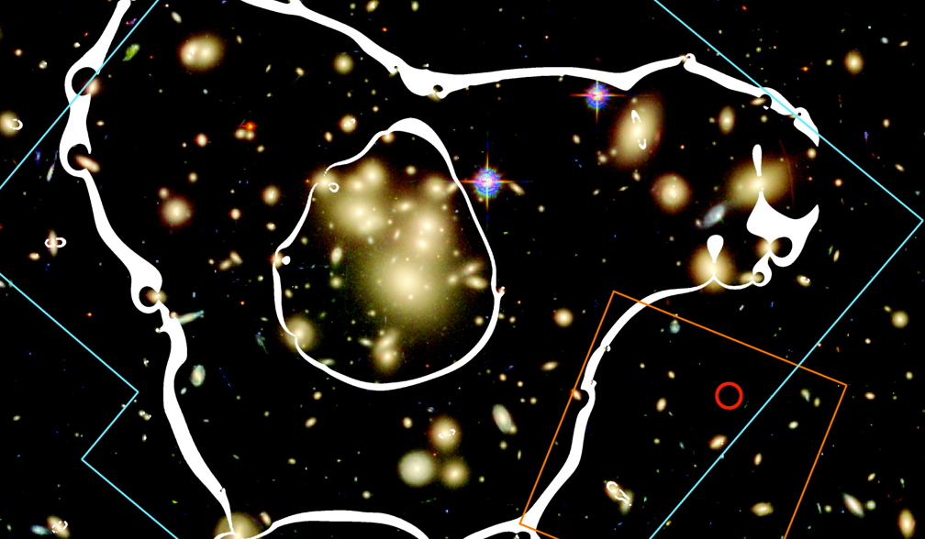
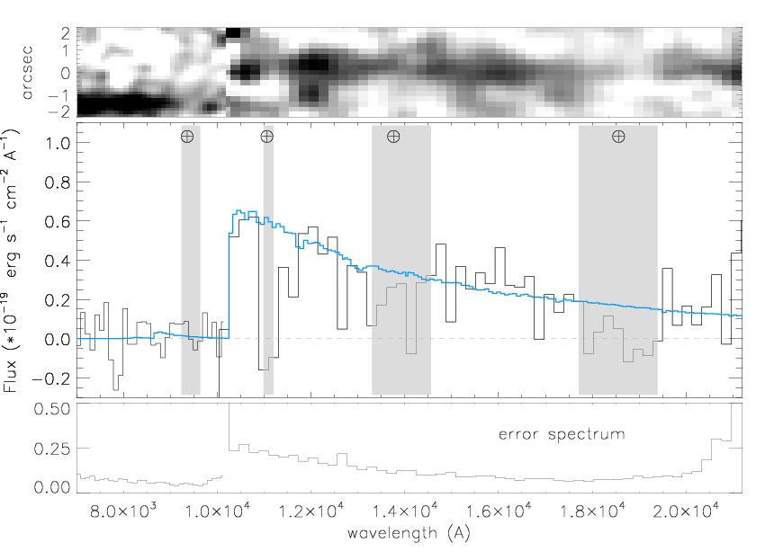
A dusty, mature galaxy in the reionisation epoch
Galaxy lensed by foreground cluster, Abell 1689
gravitationally lensed x 9
“typical” star-forming galaxy (sub-L* ; SFR~12Mo/yr)
X-shooter spectroscopy
Spectroscopy of most distant lensed galaxy
No lines
Stellar continuum spectroscopy
z = 7.5 ± 0.2
Watson et al. 2015, Nature; doi:10.1038/nature14164
GTO: 12 hours (Watson et al.)
GO: 10 hours (Bouwens et al.)

Slide 4
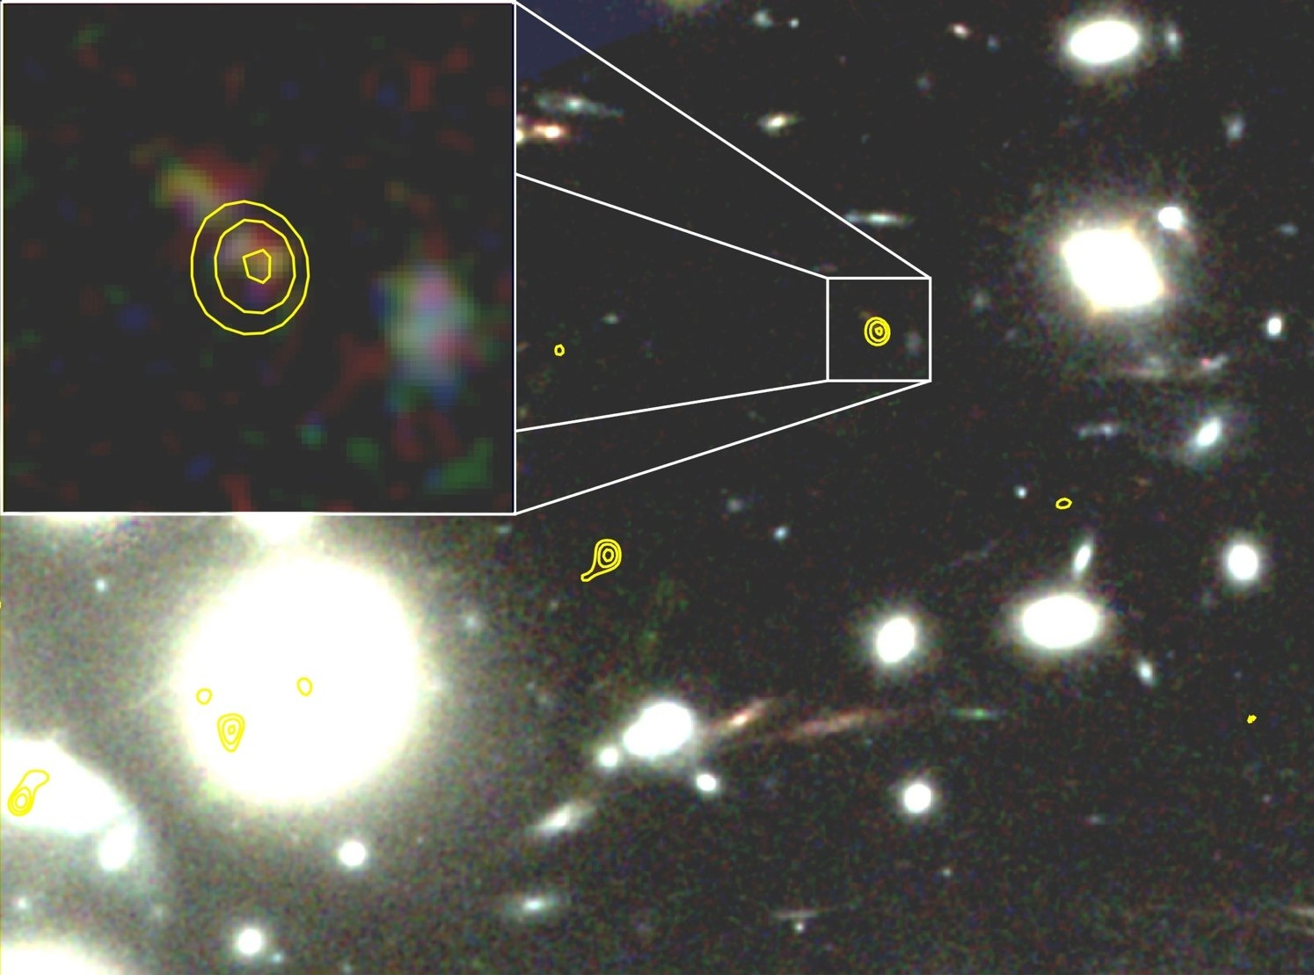
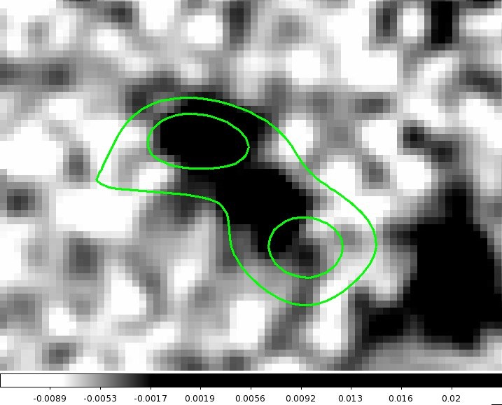
Detection of most distant dust-emitter with ALMA
Cycle 0 & 1 226 GHz
Cycle 2 226 GHz
Watson et al. 2015, Nature; doi:10.1038/nature14164

Slide 5
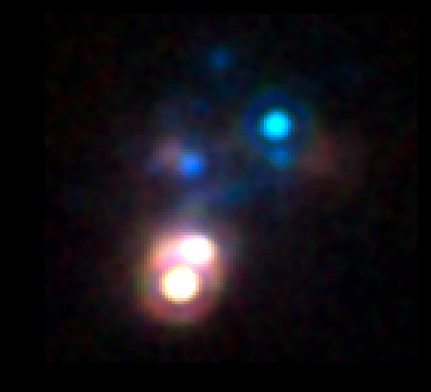
Survey of nearby galaxies
SBS 0335–052
HST/NICMOS
Small local galaxies (e.g. BCDs) offer opportunities to look at galaxies across a range of ages.
Low-z, metal-poor starbursts have hotter dust, harder radiation fields, and frequently high gas densities.
CO-dark gas prevalent at low metallicity. Hard to get at without being able to examine galaxies in detail
Low-z galaxies offer a means to examine in detail chemically unevolved systems, similar to high redshift galaxies.
Reines et al. 2008

Slide 6
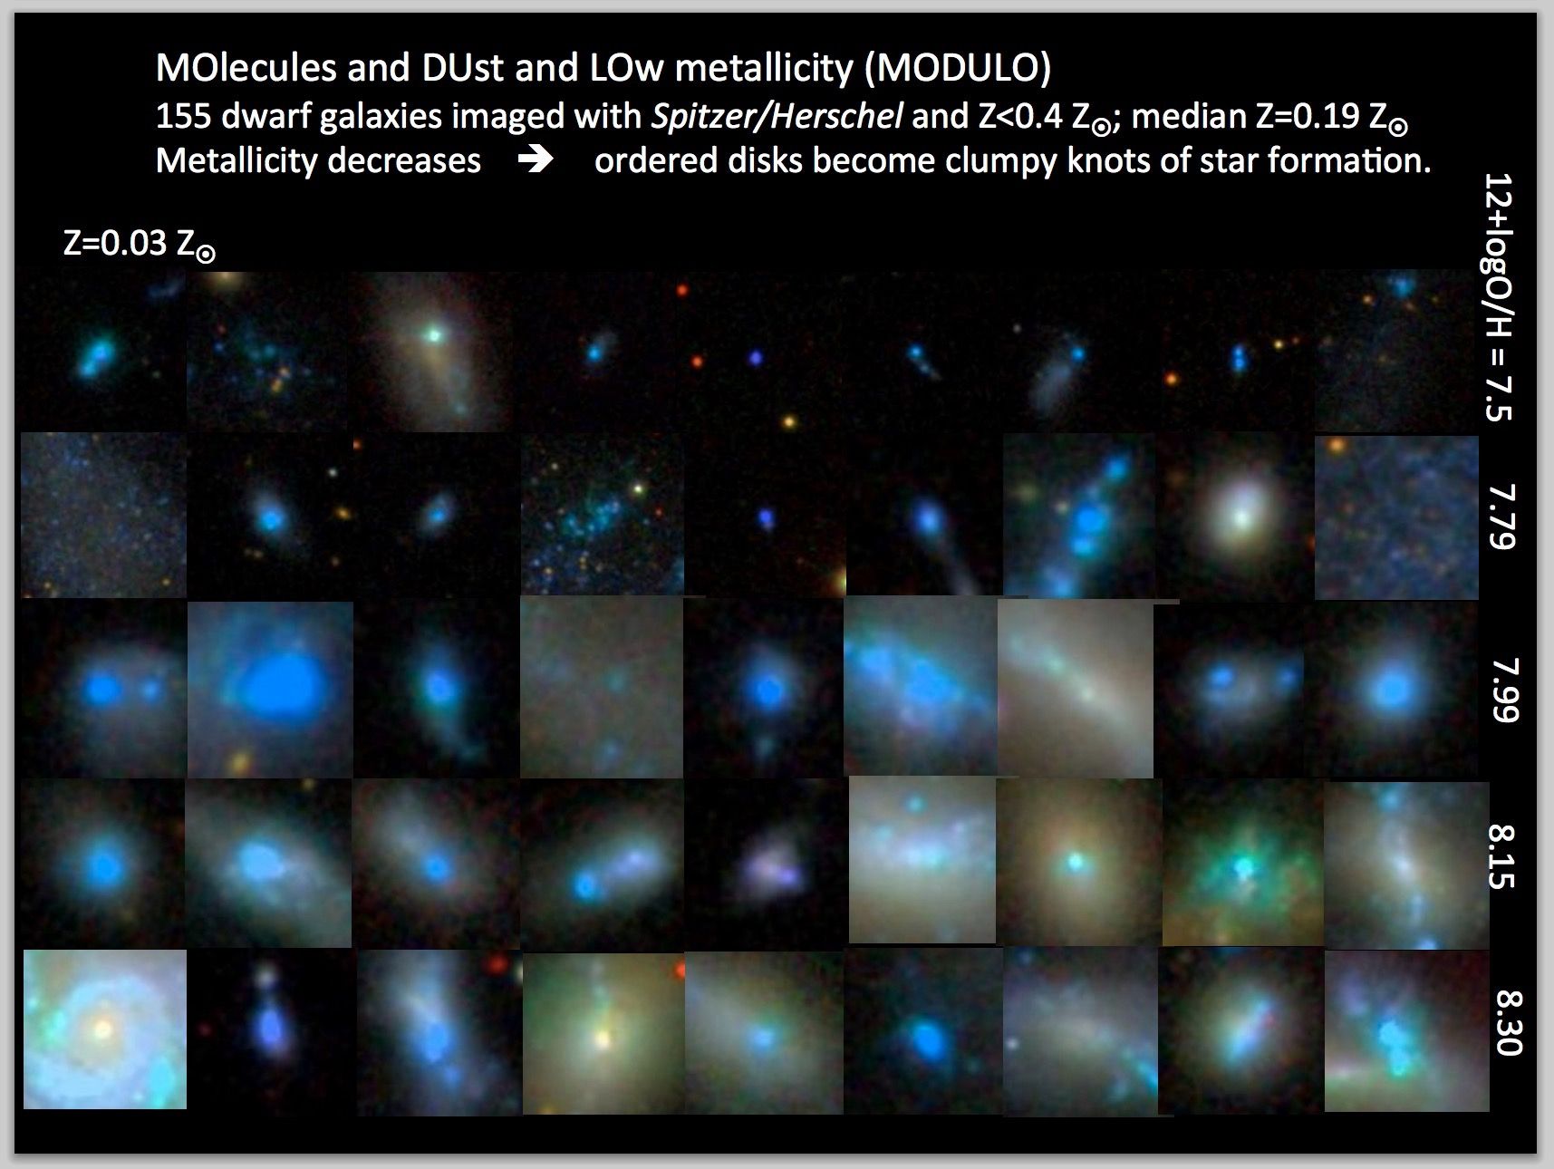

Slide 7
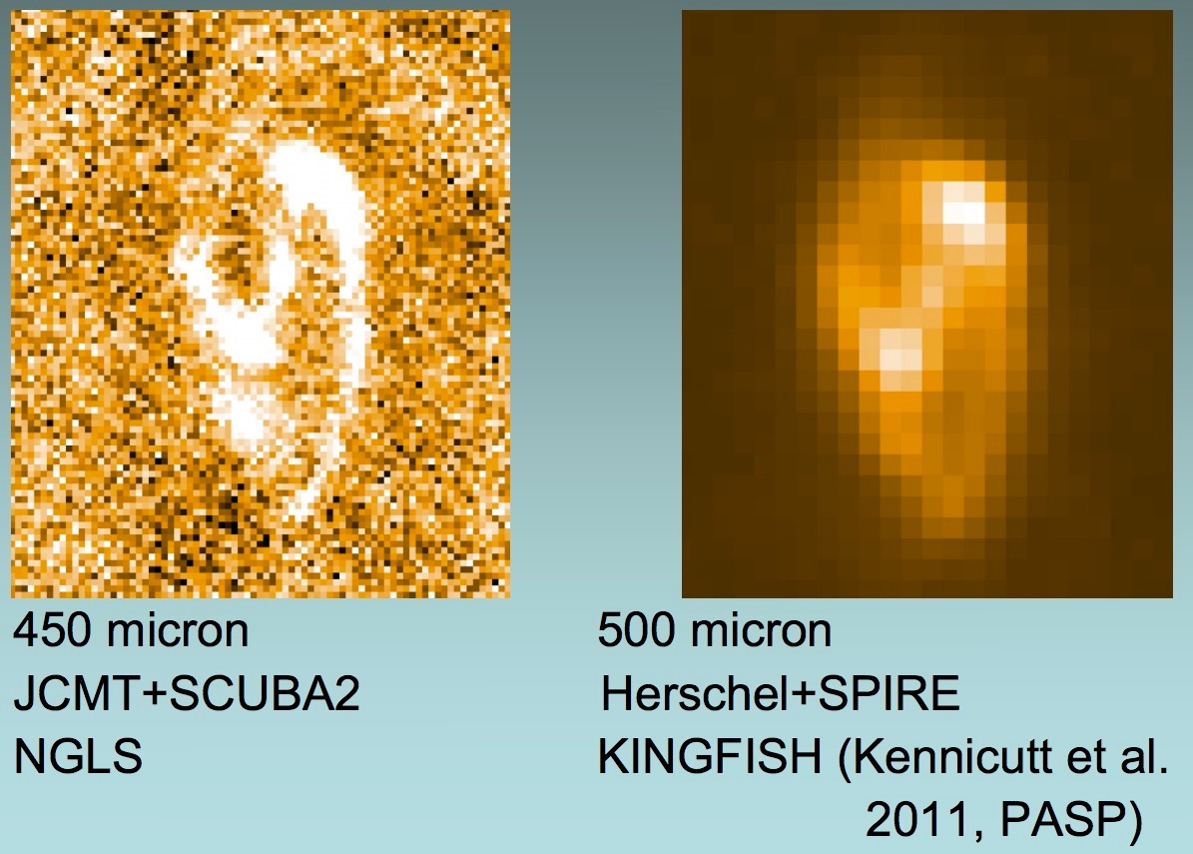
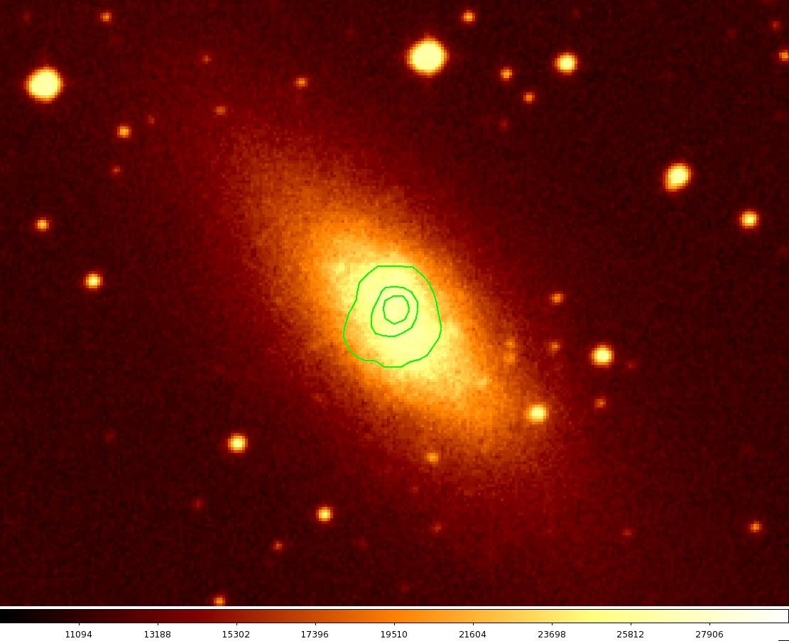
Resolve cold dust in nearby galaxies
Higher-resolution high-frequency imaging than Herschel
Resolve dust and gas emission from SSCs in nearby star-forming galaxies
Get resolved gas-to-dust ratio from dust continuum and CO maps.
Herschel/PACS 160µm contours on optical

Slide 8
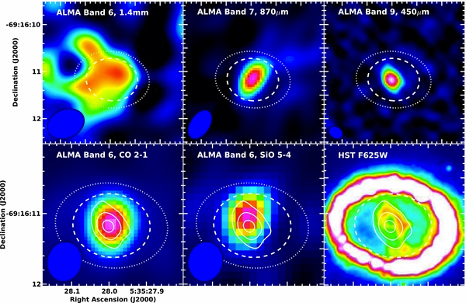
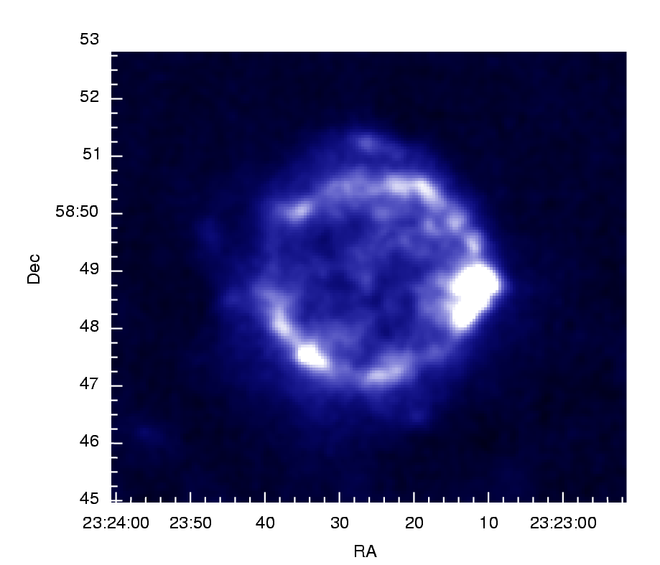
Where does dust actually come from?
Dust formed in large quantities in some core collapse SNe — are SNe dominant dust producers?
SN1987A shows ~0.5Mo of dust.
What about other remnants?
Crab — 0.1–0.3Mo
Cas A — 0.05–1Mo -> large foreground
SN1987A
Indebetouw et al. 2014
Matsuura et al. 2011
Cas A (850µm)

Slide 9
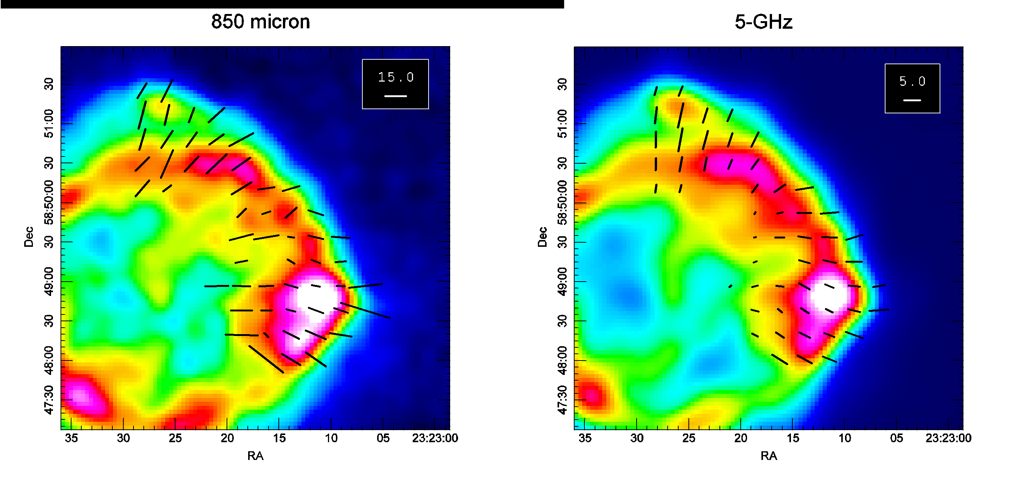
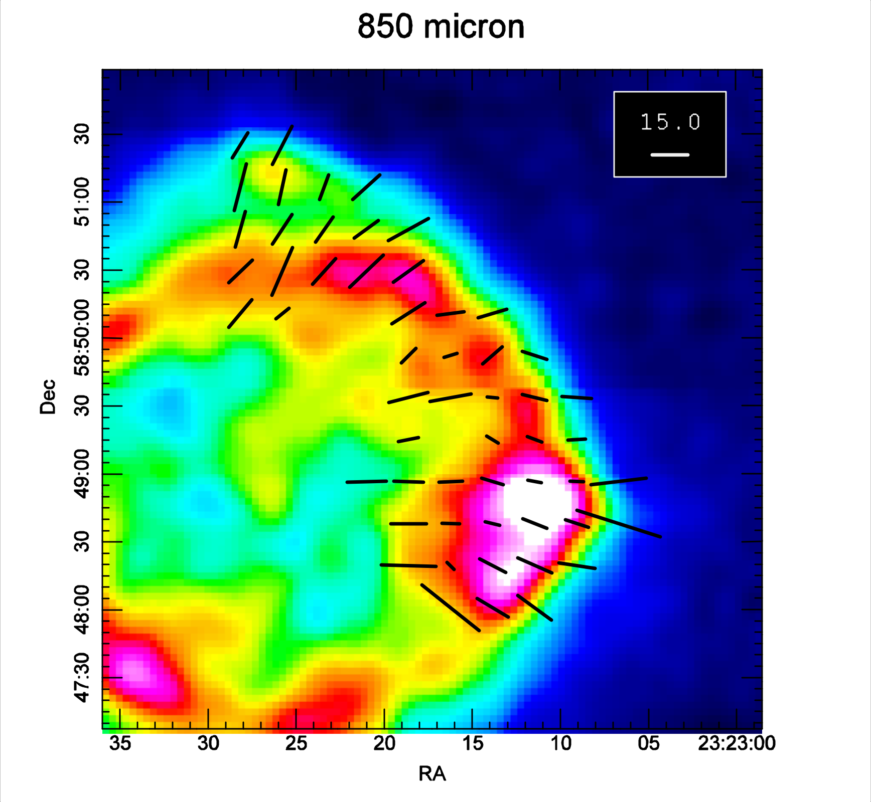
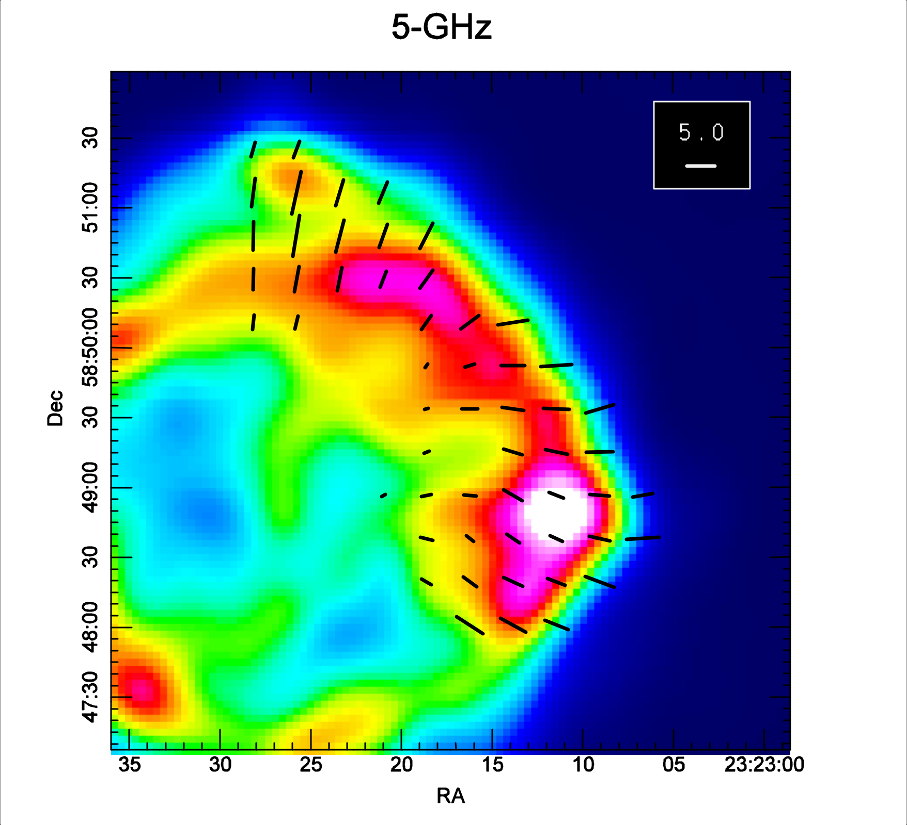
SCUBA polarimetry of Cas A
Dunne et al. 2009, MNRAS, 394, 1307
Cas A shows much stronger polarised emission at sub-mm wavelengths compared to
the radio. The direction of the sub-mm polarisation is consistent with the radial magnetic
field indicated by synchrotron.
2. Sub-mm polarimetry of Cas A
2. Sub-mm polarimetry of Cas A
Fig. 1: (Left) Sub-mm polarisation vectors overlaid on the SCUBA 850 micron map [1]. Vectors are rotated by
90 degrees to show the direction of the magnetic field. (Right). 5-GHz vectors overlaid on a 5-GHz image, corrected for rotation measure. The sub-mm polarisation is a) aligned with the field of the remnant and b) much greater than that at 5-GHz
Fig. 1: (Left) Sub-mm polarisation vectors overlaid on the SCUBA 850 micron map [1]. Vectors are rotated by
90 degrees to show the direction of the magnetic field. (Right). 5-GHz vectors overlaid on a 5-GHz image, corrected for rotation measure. The sub-mm polarisation is a) aligned with the field of the remnant and b) much greater than that at 5-GHz

Slide 10
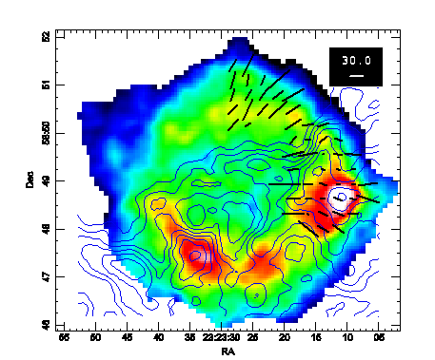
Cold dust in Cas A!
This image is synchrotron subtracted 850 micron with synchrotron corrected polarisation vectors. Contours are CO emission
Note there is polarised and unpolarised sub-mm emission where there is no CO
On the strong CO peak, the polarised fraction decreases, consistent with some contamination of the sub-mm peak by foreground dust
Estimated mass of dust is ~ 1 Msun for kappa(850) = 0.7 m² kg⁻¹

Slide 11
“Everybody who attacks me is doomed.”
Donald Trump

